Slide 1
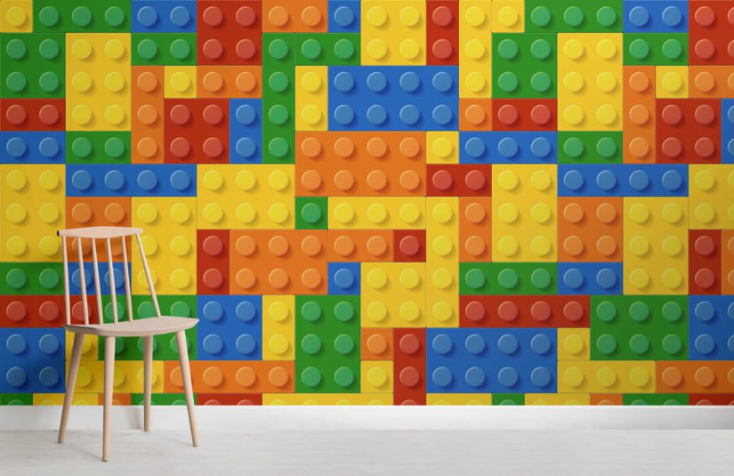
LEGOgl
Hasibur Rahman Shovon (011151031)
Laila Sultana (011151191)

Slide 2
Introduction
It’s a Lego Based Game.
Where you can choose many colors of your blocks
And pick many sizes of block
And make a lot of things and have fun ☺

Slide 3
Individual Task
Name | Task
Laila Sultana | 1) LEGO MAN 2)Block he is holding
Hasibur Rahman Shovon | Changing color Scaling Storing all the blocks

Slide 4
FUNCTIONS
Button | Task
W / S / A / D | Goes front ,back ,left ,right
Q / E | Goes Up, Down
1 / 2 / 3 | Changes color
Z / X | Scales the box in X-axis
C / V | Scales the Box in Y-axis
B / N | Scales the box in Z-axis
Cursor | Changes Camera Angle
Page down /up | Zoom in/ out

Slide 5
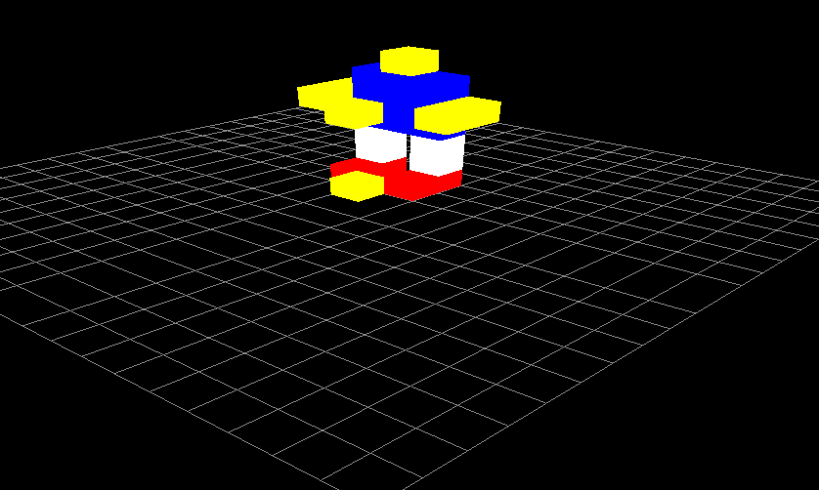
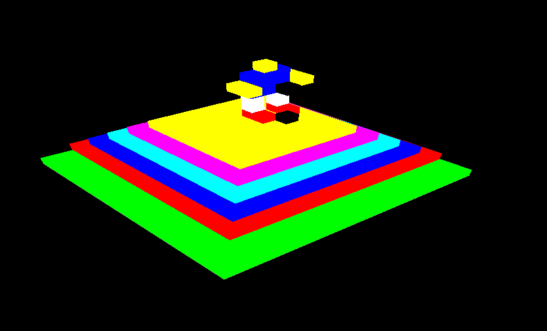
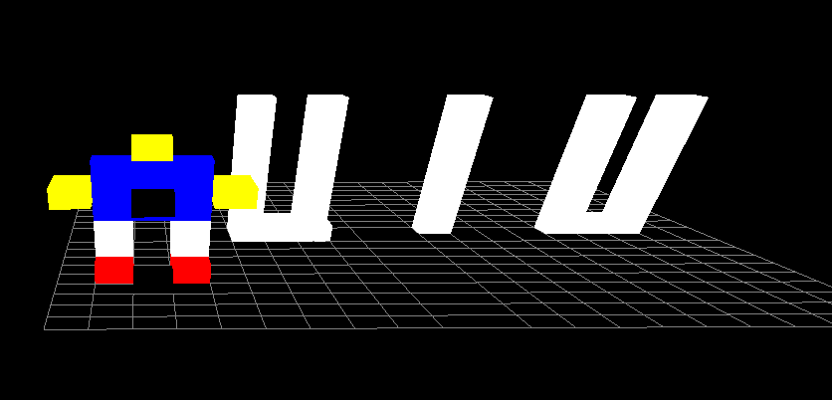
Screen Shot

Slide 6
Future Plan
A face for the LEGO Man.
A texture based scenario which updates seeing where the sun is.
Stacking blocks.
Using more colors

Slide 7
THANKyou

